Slide 1
PROJECT PRESENTATION OF FULL STACK DEVELOPMENT Presented by- Submitted to- Submitted by : Submitted To: Abdul rehman Mr. Sanjeev soni Senior faculty (i-nurture)
TOPIC - FIT CLUB

Slide 2
ABOUT AND OBJECTIVE
In online Fit Club website we are compare various categories of plans in affordable price . This website is very useful for all of you because its helps to improve your health and body posture. Its is also a dynamic and responsive website.
For those who are disabled and elderly, who cannot get out of the house, people who don’t have anybody to physically support them, the online Fit Club website is very useful this is the main purpose of online Provide a 140+ coaches that help you to make fit our body.

Slide 3
MODULES
HTML
CSS
JAVASCRIPT
Reactjs
Email js
HTML - HTML stands for HyperText Markup Language. It is a standard markup language for web page creation. It allows the creation and structure of sections, paragraphs, and links using HTML elements (the building blocks of a web page) such as tags and attributes.

Slide 4
CSS- CSS stands for Cascading Style Sheets language and is used to stylize elements written in a markup language such as HTML.
JAVASCRIPT- JavaScript is a dynamic programming language that's used for web development, in web applications, for game development, and lots more. It allows you to implement dynamic features on web pages that cannot be done with only HTML and CSS.

Slide 5
ReactJS- ReactJS is a declarative, efficient, and flexible JavaScript library for building reusable UI components. It is an open-source, component-based front end library which is responsible only for the view layer of the application. It was initially developed and maintained by Facebook and later used in its products like WhatsApp & Instagram.
Email JS - EmailJS is a JavaScript library that helps send emails using only client-side technologies. The cool thing about EmailJS is that no servers are required; all you have to do is connect it to one of the supported email services, create an email template, and use EmailJS to trigger an email.

Slide 6
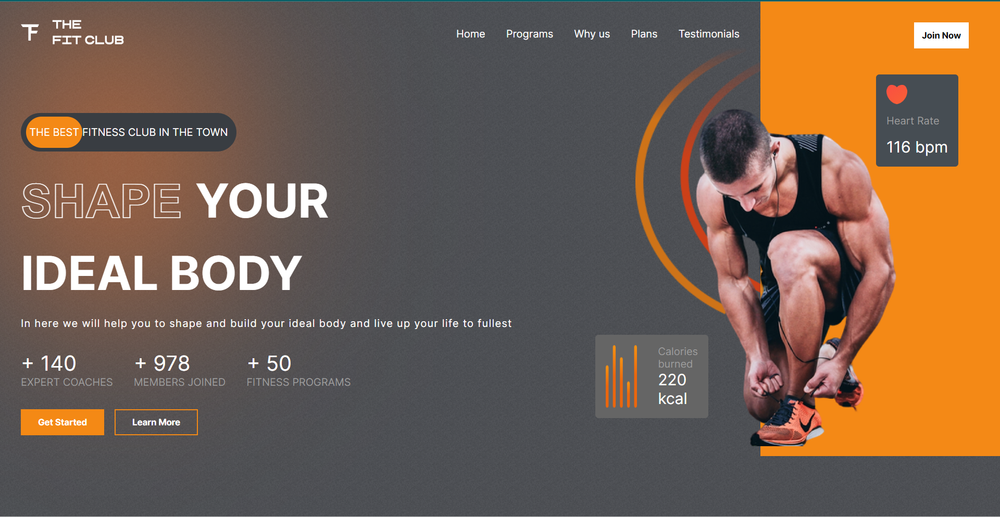
SCREENSHOT OF THE PROJECT

Slide 7
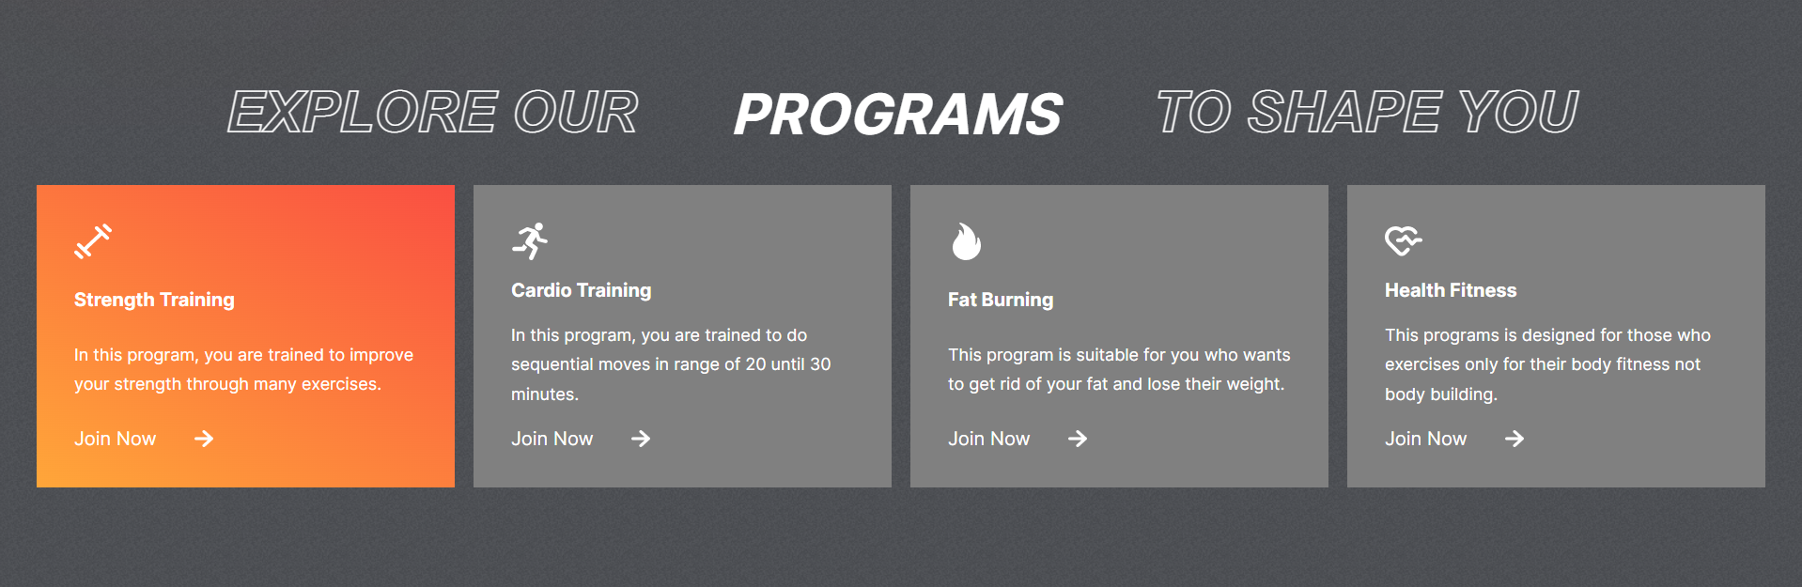
SCREENSHOT OF THE PROJECT

Slide 8

SCREENSHOT OF THE PROJECT

Slide 9
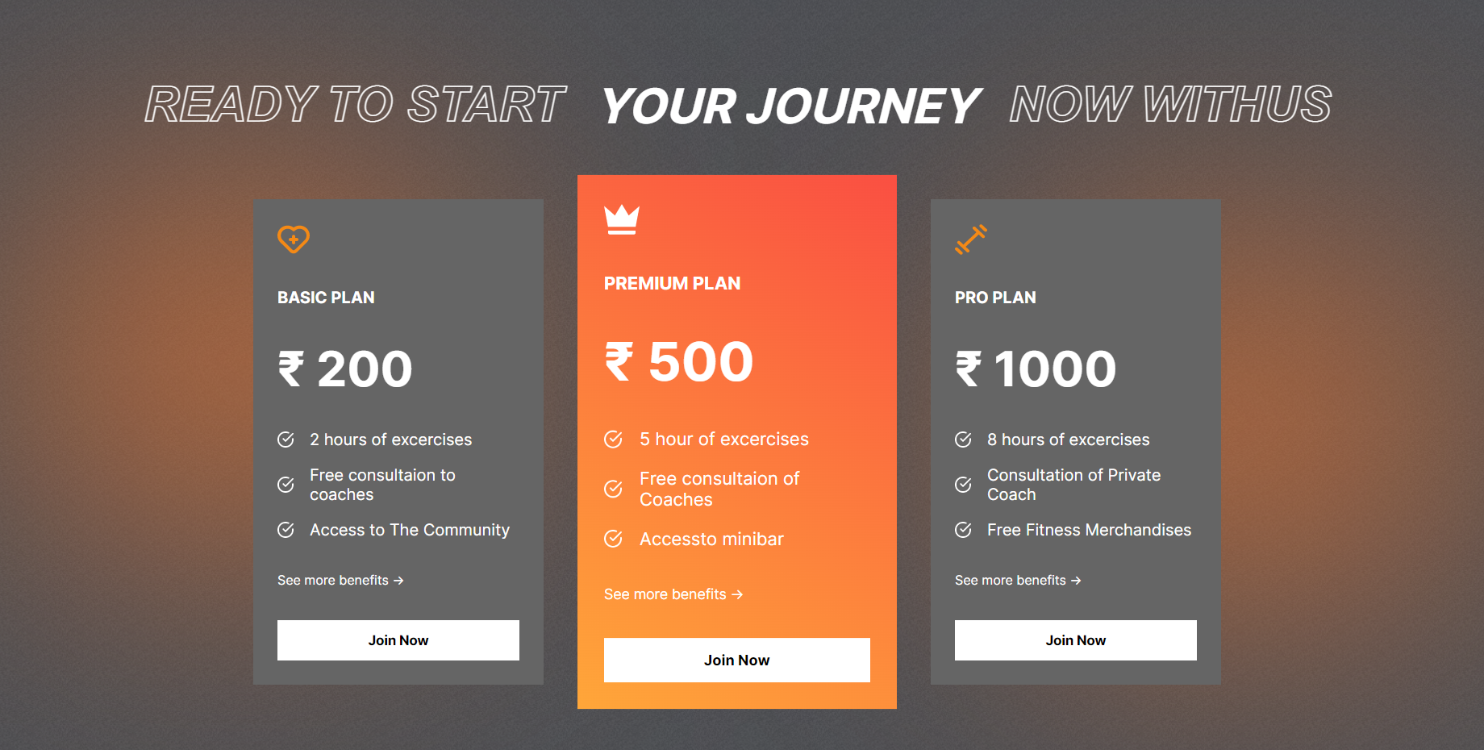
SCREENSHOT OF THE PROJECT

Slide 10

SCREENSHOT OF THE PROJECT

Slide 11

SCREENSHOT OF THE PROJECT

Slide 12
THANK YOU

